Slide 1
Real Time Operating System
Aman Kanwar

Slide 2
Agenda
Introduction and History
Role of an OS in Real Time Systems
Conventional programming approach and multi-tasking
Features of Real Time Operating Systems
Application of RTOS
Summary

Slide 3
History Unix 1980s
SVR4 was designed as a multi-user environment.
In SVR4, a program is an executable file, and a process is an instance of the program in execution (called as UNIX Process)
SVR4 enabled multitasking, processes to share single processor by implementing time quantum for each process.
Kernel at the heart of SRV4 systems implements fair-share policy for the CPU.
Goal being no process should get starved of CPU.
Here priority of a process is a function of recent CPU usage, with processes getting lower priority if they recently used the CPU.
The context for a process is its state (running/blocked), values in Global, processor registers and contents of RAM.
For memory protection MPU HW support exits.

Slide 4
History RTOS 1980s
Starting from VRTX, pSOS and iRMX to one of the best RTOS design available today called as VxWorks along with FreeRTOS, TI-RTOS, BlackBerry QNX, RT-Linux, etc.
These all supported a form of multiprogramming (similar to UNIX), but specifically for real-time.
Here UNIX’s fair-share approach was not appropriate for systems with fixed deadlines to meet.
RTOS programming model is referred to as MultiTasking.
Significant differences are there between a Unix Process and RTOS task involving the exclusion of MMU (in most cases)
Context switch with MMU is much slower than without.
MMU introducing page-faults are not friendly with real-time requirements.
Majority implements Priority pre-emptive sched.

Slide 5
History RTOS 1980s cont…
Rather than developing separate C programs, a single program is broken into a number of functions (tasks) and each function later behaves as it was a main function.
The unit of concurrency for all RTOS flavors mentioned above is task and not process.
All tasks are developed as a part of a single program.
The Context of a task differs from Unix process as
  All tasks share the same linear physical address space.
  All tasks share address map sections (.text, .data, .bss, .rodata and the heap).
Significant differences are there between a Unix Process and RTOS task involving the exclusion of MMU (in most cases).
Performing a Context switch between two task is similar to process but with no MMU overhead plus linear address space.
ISRs can communicate with the tasks easily.

Slide 6
Major Difference
In RTOS order of Task scheduling and thus responsiveness of system are under the control of the programmer and not Kernel!

Slide 7
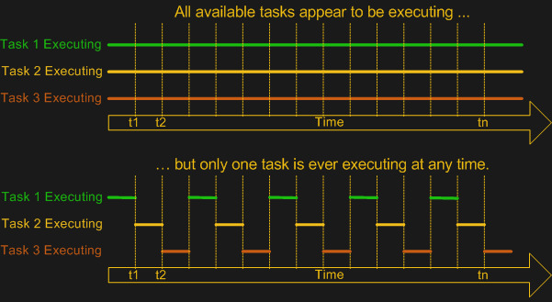
Multitasking on Uni-processor system

Slide 8
What is Real Time ?
“Real Time in operating systems”
The ability of the operating system to provide a required level of service in a bounded response time.
In short a system is said to be Real Time, if it is required to complete it’s work and deliver it’s services on time, example includes Flight control system

Slide 9
Hard and Soft Real Time Systems
Hard Real Time Systems
  Failure to meet the deadline is fatal
  Example: Automatic breaking systems, flight control systems
Soft Real Time Systems
  Late task completion is not desirable but not fatal.
  Performance degrades as more jobs miss deadlines
  Example: Environmental sensor beacon, home electronics

Slide 10
Role of Kernel in Real Time Systems
Standalone applications
  Generally with no kernel involved implemented via conventional programming using super loop.
  Microcontroller based Embedded system (bare-metal applications)
  Unable to handle complex task requesting multi-tasking

Slide 11
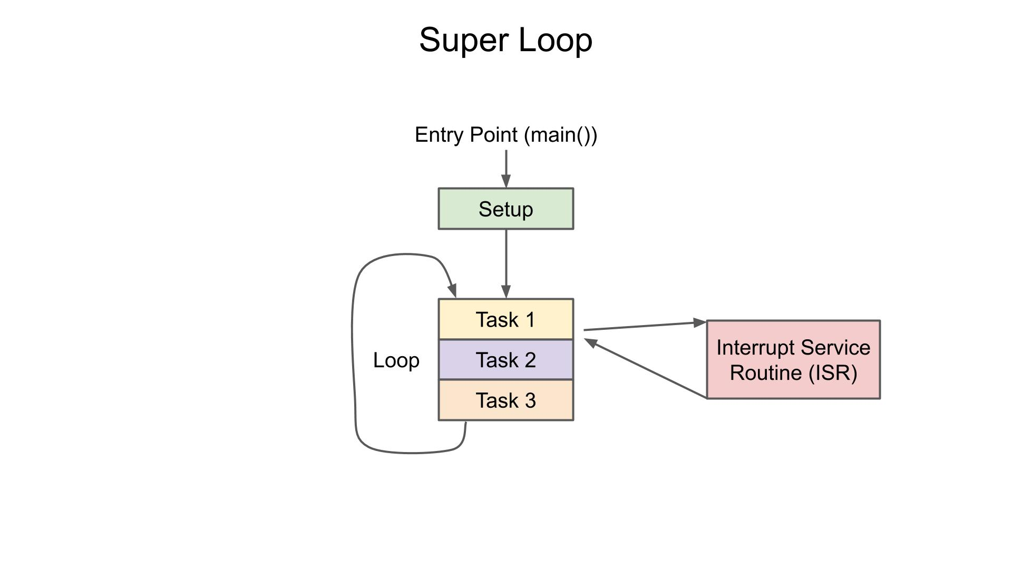

Conventional programming style

Slide 12
Issues with conventional approach
LED Toggle example:
Toggle Led A (every 1 sec)
Toggle Led B (every 2 sec)
Toggle Led A (every 1 sec)
Toggle Led B (every 2 sec)
Toggle Led C (every 3 sec)
Increasing the requirements will increase the implementation
Complexity using conventional approach

Slide 13
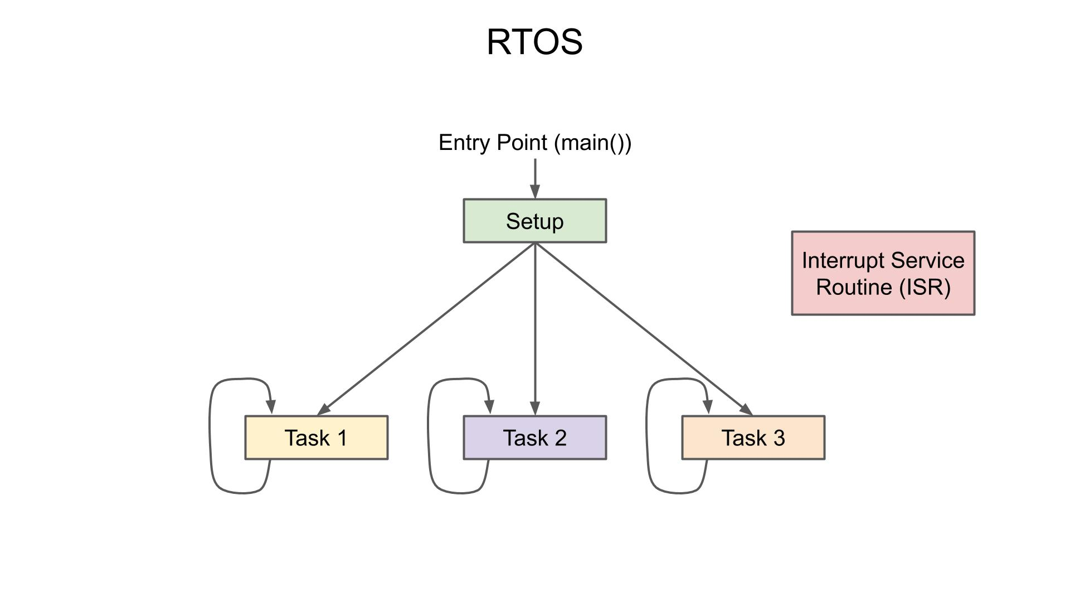
Multitasking application (RTOS)

Slide 14
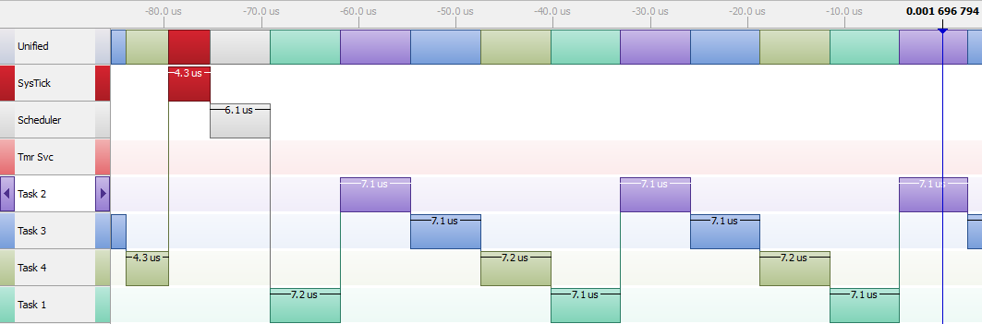
(RTOS approach)

Slide 15
(Conventional approach)
Fixed timing
Variable timing
Fixed timing
Fixed timing
Task 1
Led Glow
Task 2
Sensor Data Read
Task 3
Sensor Data send UART
Task 1
Led Glow
Time

Slide 16
Some Terminology
A task is a set of instructions loaded into memory. It can also mean some unit of work or goal that needs to be accomplished.
A thread is a unit of central processor (CPU) utilization with its own program counter and stack memory.
In RTOS context, Task and Threads are interchangeable terms.

Slide 17
Features of RTOS
Task Management
Scheduling
Resource Allocation
Interrupt Handling

Slide 18
Task Management
In Real Time Applications the Process is called as Task which takes execution time and occupies memory.
From programming point of view, it’s just a subroutine implementation which is having one super-loop inside it
Task management is the process of managing task through its lifecycle.

Slide 19
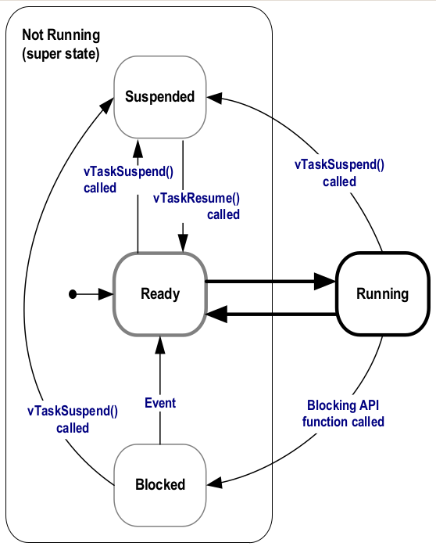
Task State

Slide 20
Scheduling and Throughput
GPOS, scheduler uses a fairness policy to dispatch threads and processes onto CPU.
RTOS, threads/tasks execute in the order of their priority.
In an RTOS high priority task will take over the CPU till the time there is no other high priority task available to take over the CPU.
In RTOS low priority tasks do not get a chance to execute if a given High priority task is in ready state.
Preemption will occur by high priority task only.

Slide 21
RTOS vs GPOS
Latency means the time elapsed between a given generated event and the response of our task/process to that event.
Response time for RTOS and GPOS can be different.
RTOS can provide more precise response time.
In RTOS low priority tasks do not get a chance to execute if a given High priority task is in ready state.
Preemption will occur by high priority task only.
With increase in number to process in GPOS switching latency increases in case of GPOS

Slide 22
Scheduling and Throughput
Task switching latency
GPOS
RTOS
CPU load (number of tasks)

Slide 23
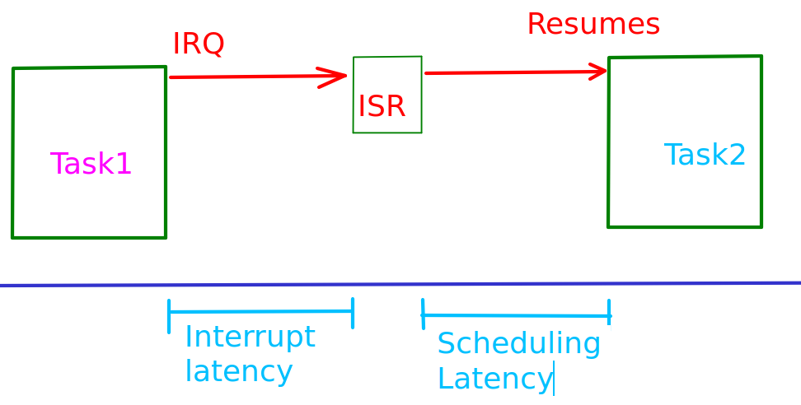
RTOS vs GPOS

Slide 24
Scheduling
Time slice driven
Round-robin
Priority based
Corporative scheduling

Slide 25
Exercise
Create 3 tasks with equal priorities.
Blink LEDs in the created tasks at different time interval
Change the
  configUSE_PREEMPTION = 0
  Observe the behaviour
Add a call to TaskYeild() and observe

Slide 26
Scheduling Policy (exercise)
Scheduler will be running the tasks on the CPU based on the scheduling policy used.
With configUSE_PREEMPTION = 1 the Scheduler will be a preemptive scheduler and task switches will be happening.
With configUSE_PREEMPTION = 0, cooperative scheduler will come into action.

Slide 27
Cooperative Scheduling
It would be noted that only one task is running at any given time if we turn OFF the preemption.
In this case using the TaskYeild() API we can do something called as cooperative scheduling.
Adding the TaskYeild() API, we can see the preemption is task is switching. Here task itself is leaving the processor.
Switching of task willingly.

Slide 28
Scheduling Policy (exercise)
Scheduler will be running the tasks on the CPU based on the scheduling policy used.
With configUSE_PREEMPTION = 1 the Scheduler will be a preemptive scheduler and task switches will be happening.
With configUSE_PREEMPTION = 0, cooperative scheduler will come into action.

Slide 29
Task Creation in FreeRTOS
Calling xTaskCreate() will be doing following behind the scene.
  Memory allocation for TCB (pxTopOfStack imp).
  Dedicated Stack memory allocation for Task.
    This stack will be managed by the PSP pointer.
    Stack for kernel will be managed by the MSP.
  Putting the task under ready list for scheduler to pick.

Slide 30
HEAP (STACK allocation)
Used HEAP section based on our heap manager, is just an array “ucHeap”of size “configTOTAL_HEAP_SIZE” which is defined in FreeRTOSConfig.h
So whenever a call to malloc function will be made, malloc will be returning a memory section from the above array.

Slide 31
Task Scheduler Implementation
Implemented in tasks.c
Once started, scheduler code is initialized and arch. Specific interrupts will be activated.
Created IDLE and Timer Daemon Task.
Calls xPortStartScheduler() which perform Arch. Sepecific initializations.

Slide 32
Thank you

